Slide 1
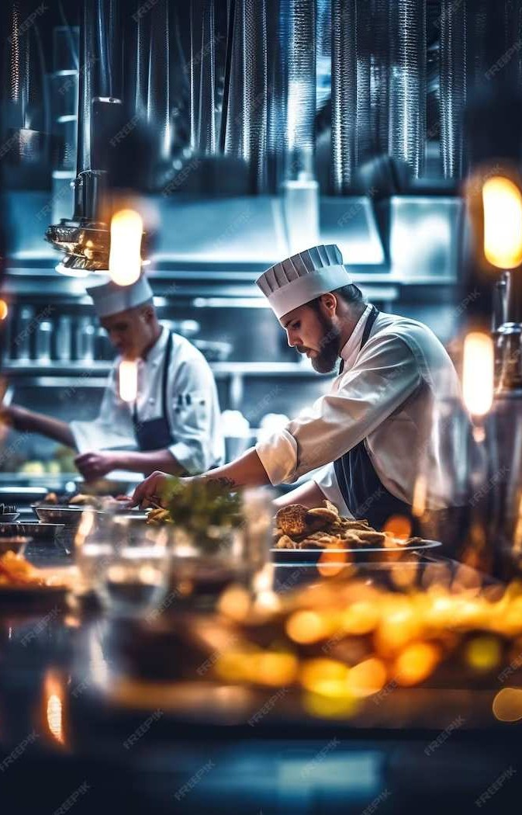
Restaurant Management System:
Fine&Dine

Slide 2
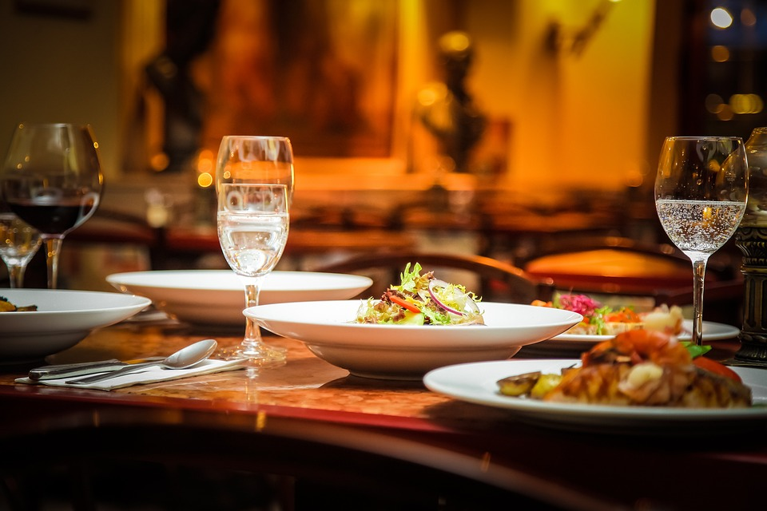
Introduction
Fine&Dine, stands as a comprehensive software solution meticulously designed to revolutionize the operations within a restaurant. It combines various functionalities into a single platform, encompassing crucial aspects like point-of-sale (POS), inventory management, table optimization, managing of cuisines and food products, managing orders and analytics. Essentially, it's the all-in-one tool that modernizes and simplifies the complex workings of a dining establishment.
This Photo by Unknown Author is licensed under CC BY-NC-ND
This Photo by Unknown Author is licensed under CC BY-NC-ND

Slide 3

Importance of RMS
Importance of an RMS in the Hospitality Industry. In an ever-evolving industry, the significance of an RMS cannot be overstated. It serves as the cornerstone for enhancing operational efficiency, reducing costs, and amplifying customer satisfaction. From small-scale eateries to large franchises, an RMS is a catalyst for success.

Slide 4
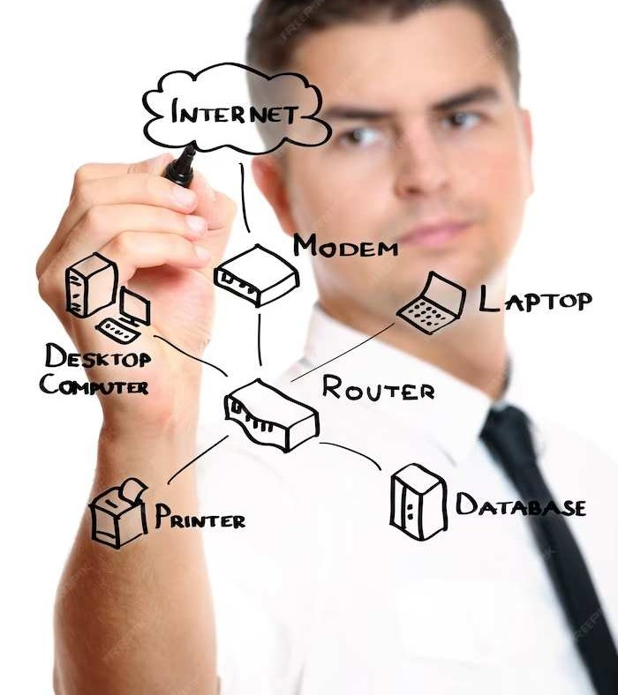
Challenges in RMS
Developing a robust restaurant management system entails several key considerations. First and foremost, data integrity is crucial to maintain accurate and consistent information in the database, with particular emphasis on implementing foreign key constraints for referential integrity. A secure user authentication and authorization system must be in place to protect sensitive data. Given the system's anticipated high transaction volume, performance optimization is imperative for reduced latency and a responsive user experience. Additionally, customization is essential, with tailored user interfaces for different roles such as admin, waiter, and chef. Lastly, scalability is a key design factor to ensure the database structure can accommodate future growth, potentially expanding to multiple branches or locations.

Slide 5

Approach
Requirements Gathering: Understand specific restaurant needs, encompassing user and client management, cuisine handling, menu creation, table reservations, order processing, inventory control, and reporting functionalities.
Design and Planning: Visualize system architecture, user interface, and database schema. Decide on the technology stack, security measures, and integration strategies.
Database Design: Develop an efficient structure considering entities like users, cuisines, tables, orders, order products, and products. Ensure data integrity and efficient storage.
Development: Implement the system using appropriate programming languages and frameworks for frontend, backend, and database components. Follow coding best practices and maintain modularity for scalability.
Iterative Improvement: Gather feedback post-implementation for identifying areas of enhancement. Continuously update and improve the system to adapt to changing business needs and technological advancements.

Slide 6

App Features
A restaurant management system is a sophisticated software solution designed to optimize diverse facets of restaurant operations. It incorporates robust user management, distinguishing between admin, staff, chef, and cashier roles with secure authentication. Cuisine management features include organized categorization, creation of food products with stock tracking, and dynamic menu management. Table management offers a visual layout, reservation capabilities, and real-time occupancy tracking for efficient seating arrangements. Order processing functionalities enable seamless creation, modification, and billing with payment options. The system relies on a comprehensive technology stack, utilizing a relational database, Node.js/Express.js for backend logic, and React.js for a user-friendly frontend. Security measures include encryption and secure authentication protocols. In summary, this system enhances operational efficiency, customer service, and overall business performance by integrating and streamlining various restaurant functions.

Slide 7
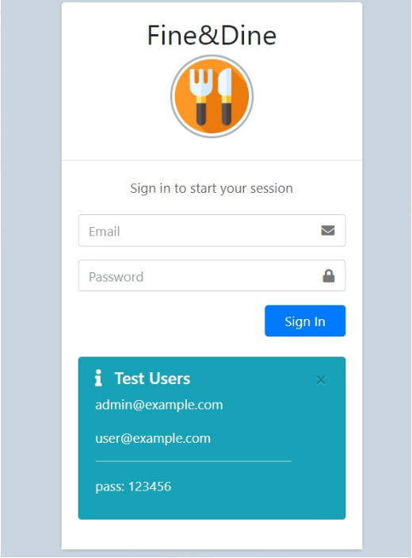
User Interface
Login Page: It is the login page where users have to log in to use the web application

Slide 8
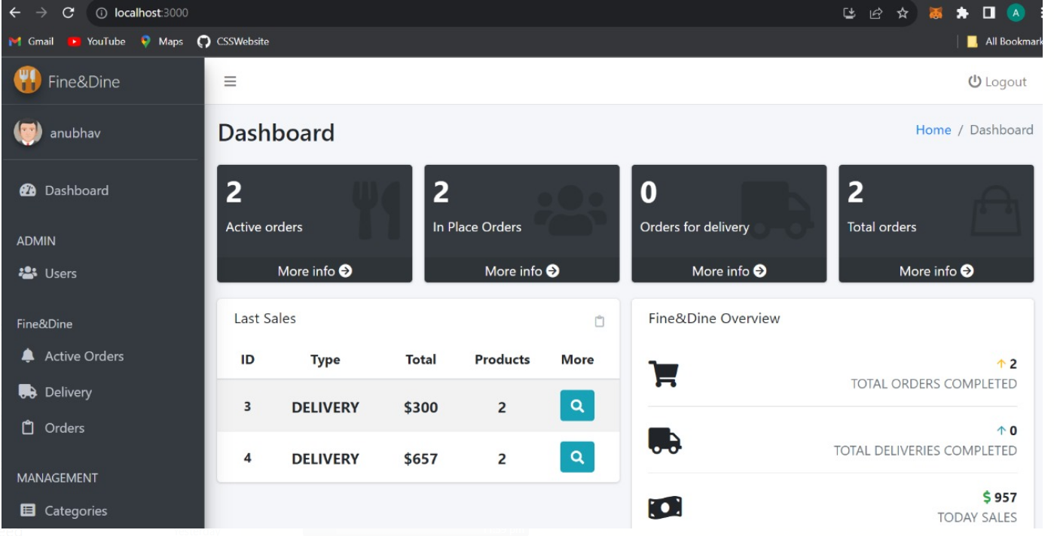
User Interface
Dashboard: It is the screen where users/clients are redirected after they login to the system. Users/Clients can choose any action to perform of the ones mentioned I the dashboard.

Slide 9
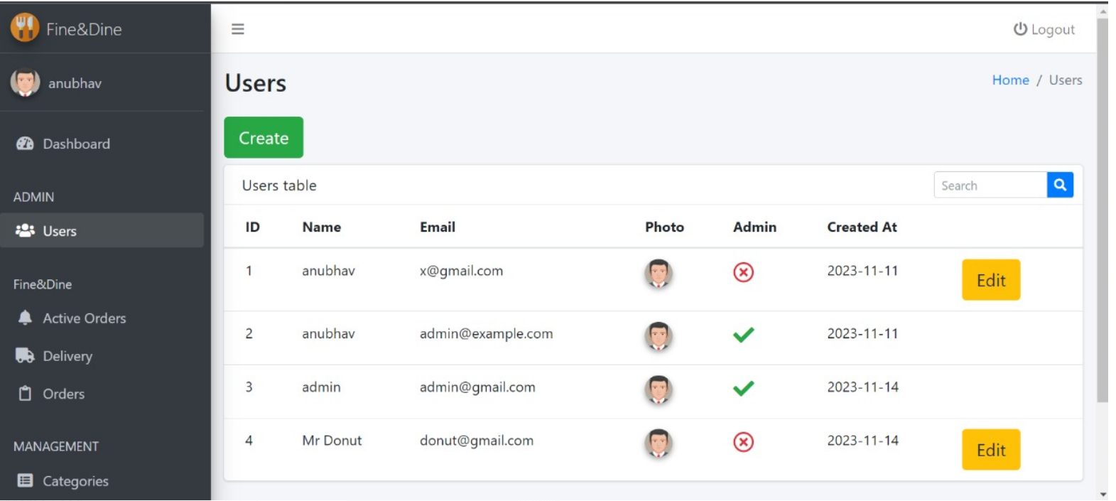
User Interface
Users: This screen shows the information about the users who have logged into the system.

Slide 10
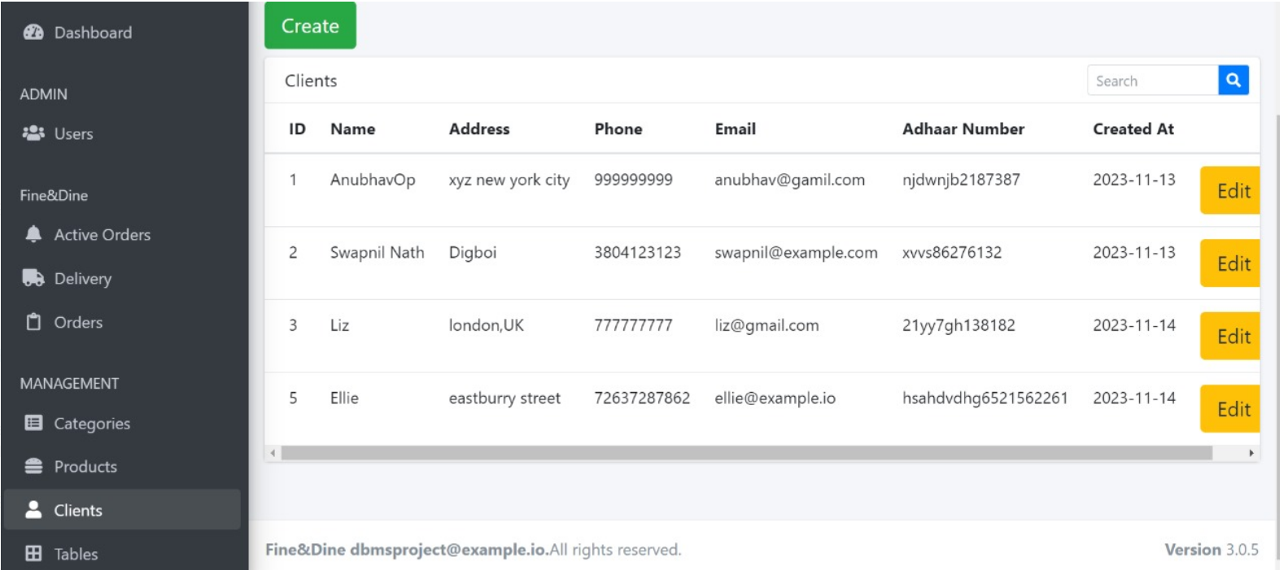
User Interface
Clients: This screen shows the information about the clients who have logged into the system.

Slide 11
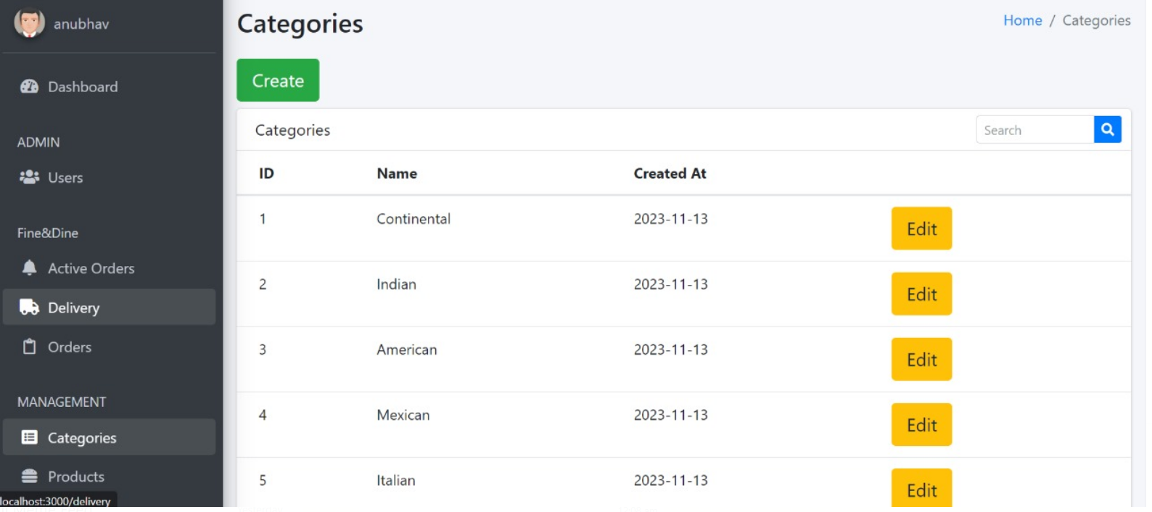
User Interface
Categories: This screen shows the different available cuisines in the restaurant.

Slide 12
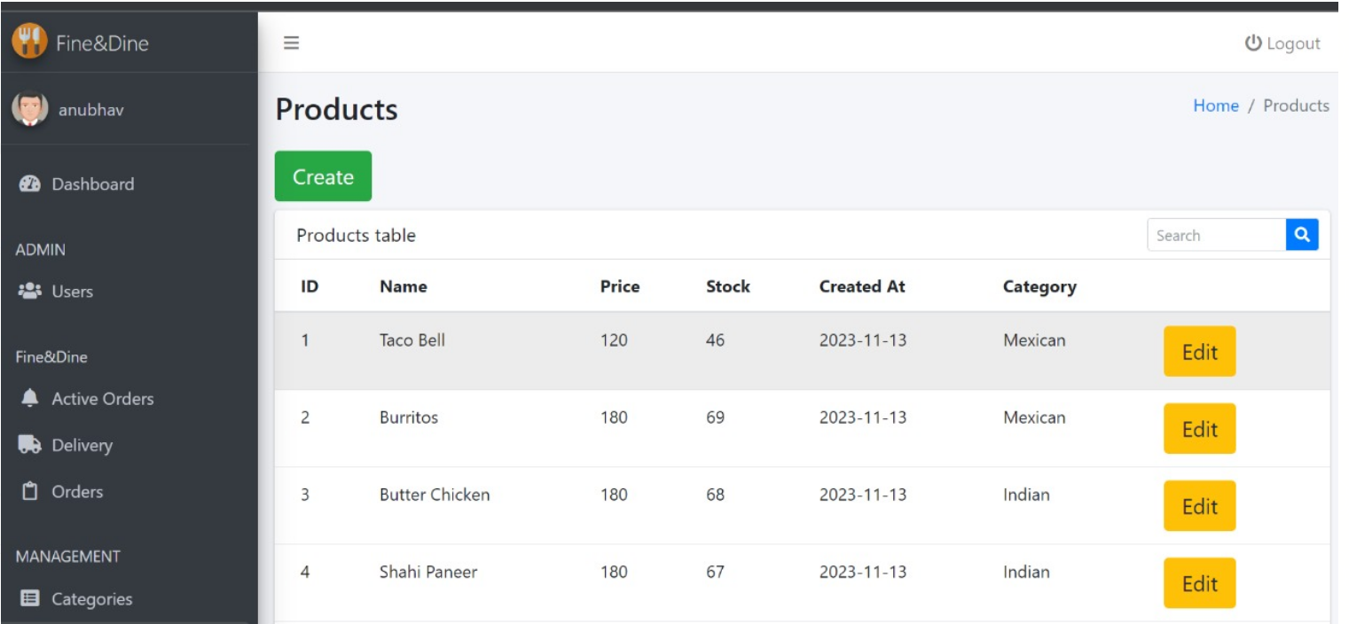
User Interface
Products: This screen shows the different available food products/dishes in the restaurant.

Slide 13
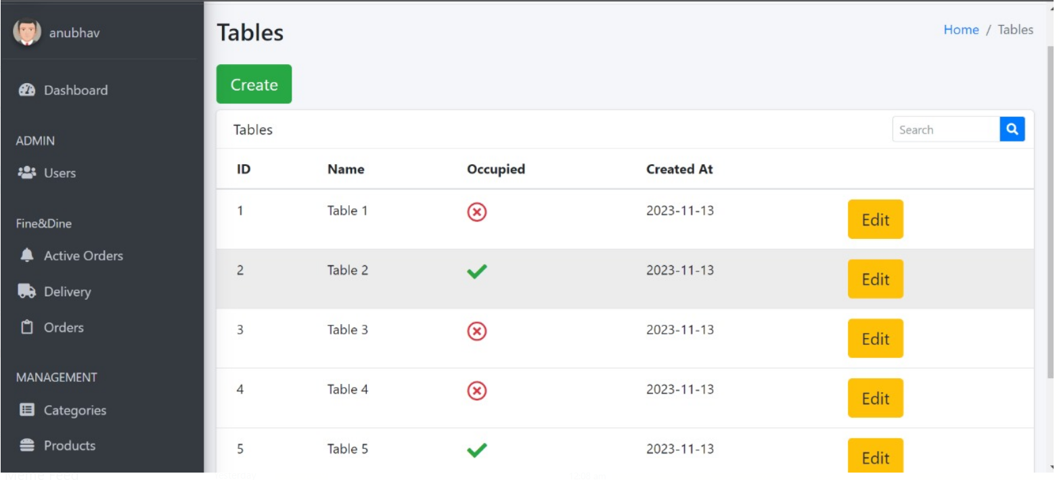
User Interface
Tables: This screen shows the different unoccupied and booked tables in the restaurant.

Slide 14
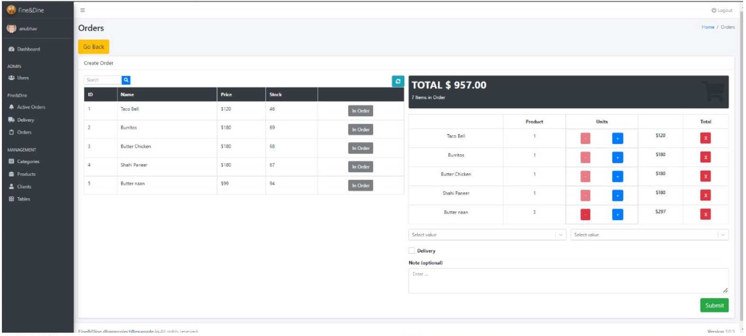
User Interface
Orders: This screen shows the different order information in the restaurant.

Slide 15
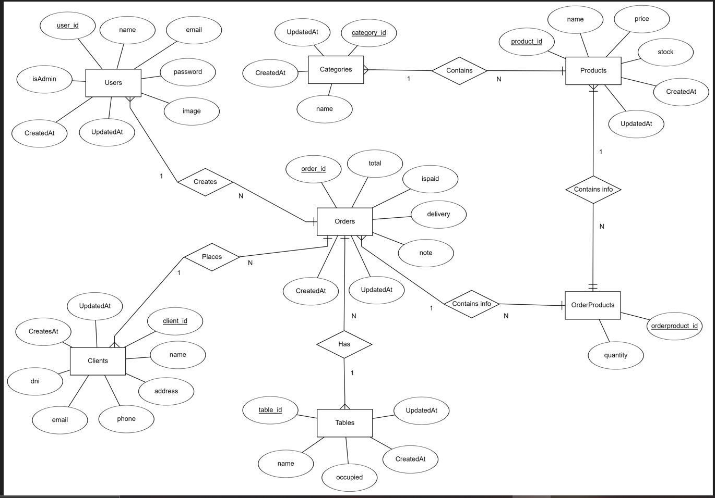
ER diagram

Slide 16
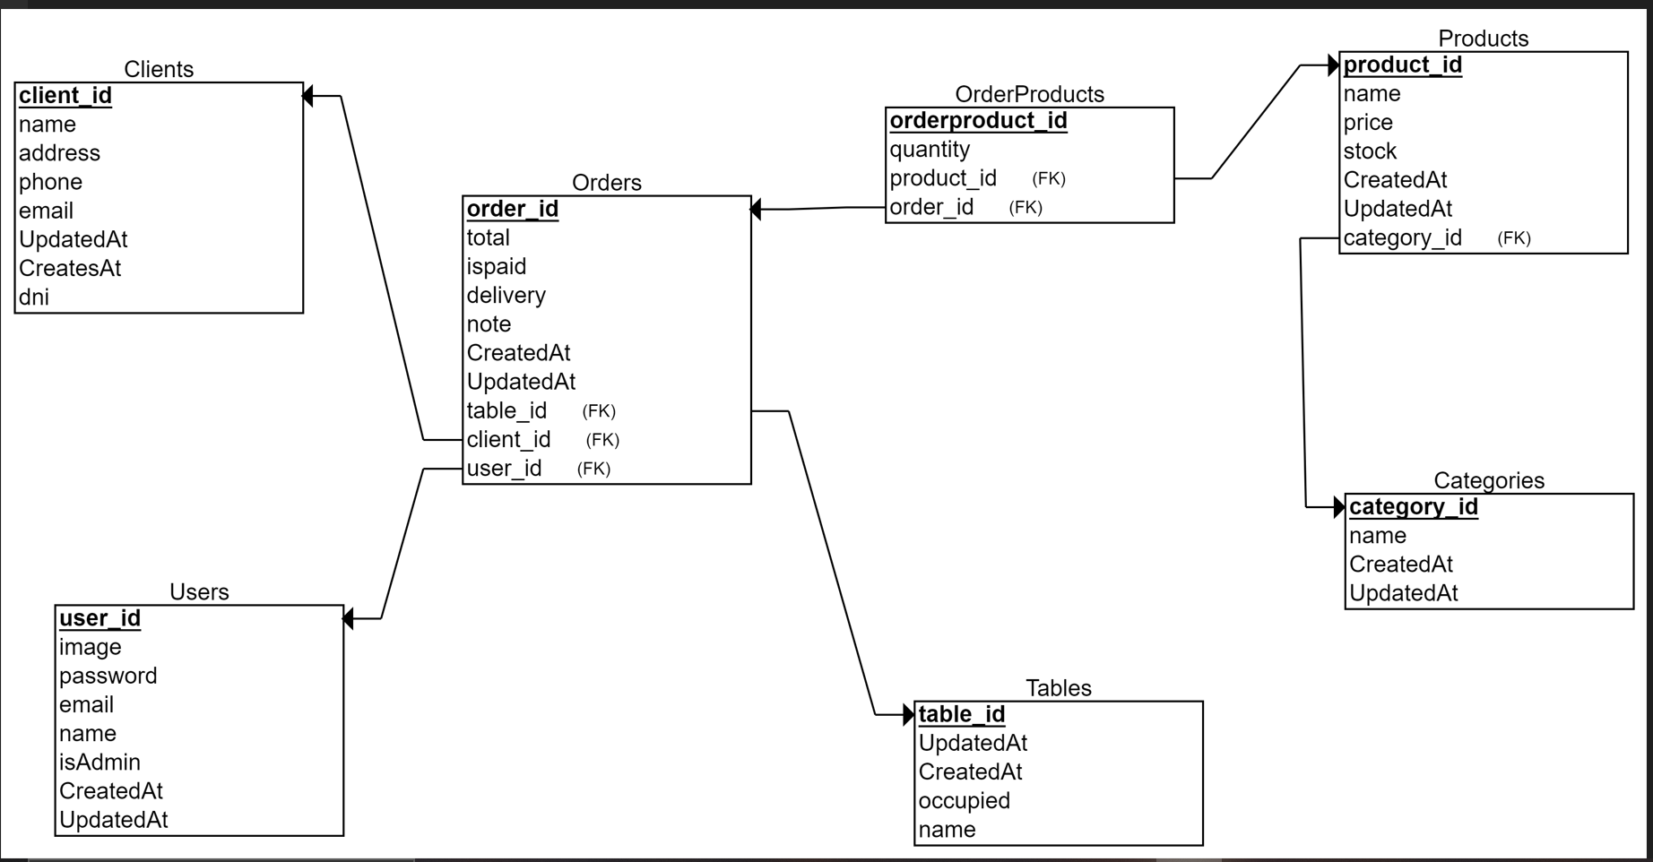
Relational schema

Slide 17
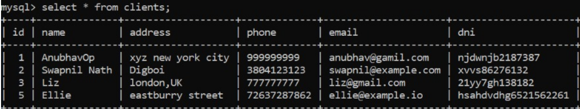
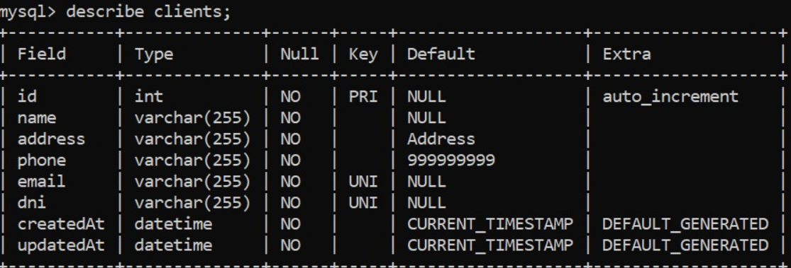
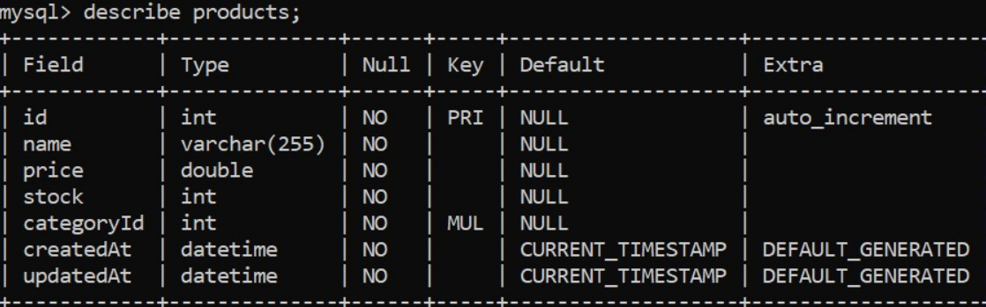
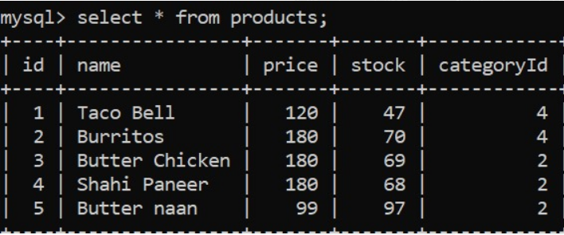
Schema & Tables
Client-
Products-

Slide 18
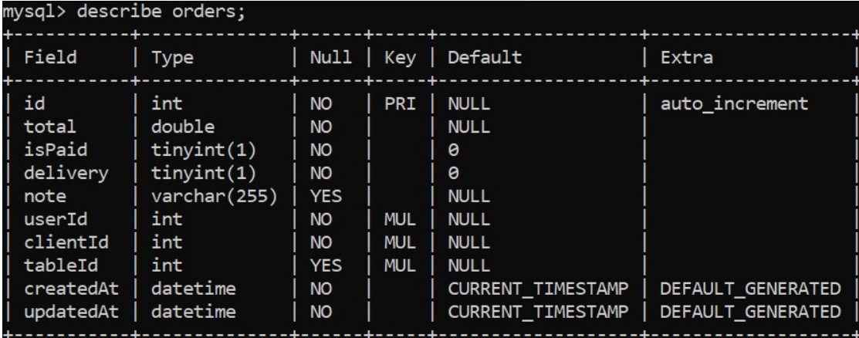
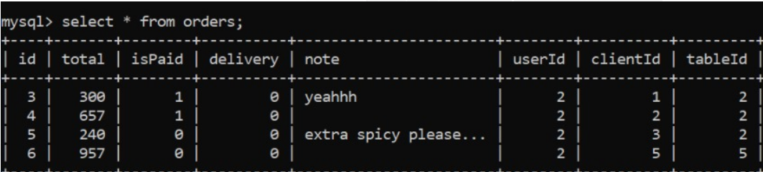
Schema & Tables
Orders-

Slide 19
Conclusion
The implementation of a React.js, Express.js and SQL-based DBMS has signiﬁcantly improved the efﬁciency and accuracy of Fine&Dine web application. Our presentation highlighted key aspects, including the importance of a systematic approach in requirements gathering, design and planning, database design, development, and iterative improvement.

Slide 20
Thank you!
Prepared by: -
Mohith Sai Teja Kothapalli (2112101)
Mummidi Satyanarayana (2112102)
Swapnil Nath (2112103)
Anubhav Chakraborty (2112104)
Parimi Vedavalli (2112105)

